Slide 1
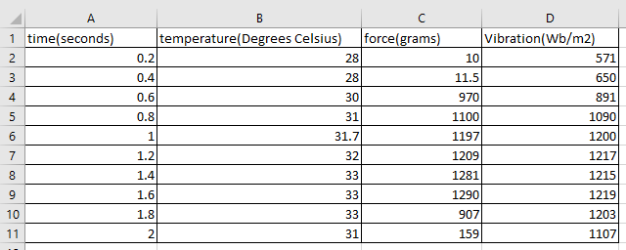
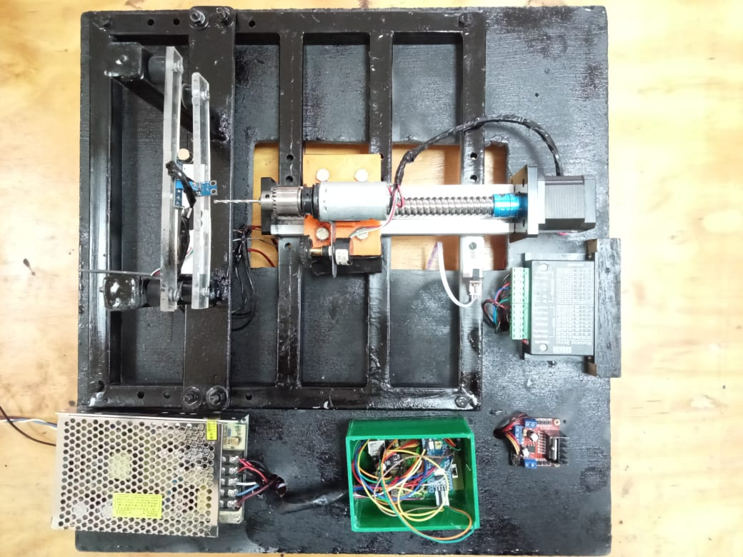
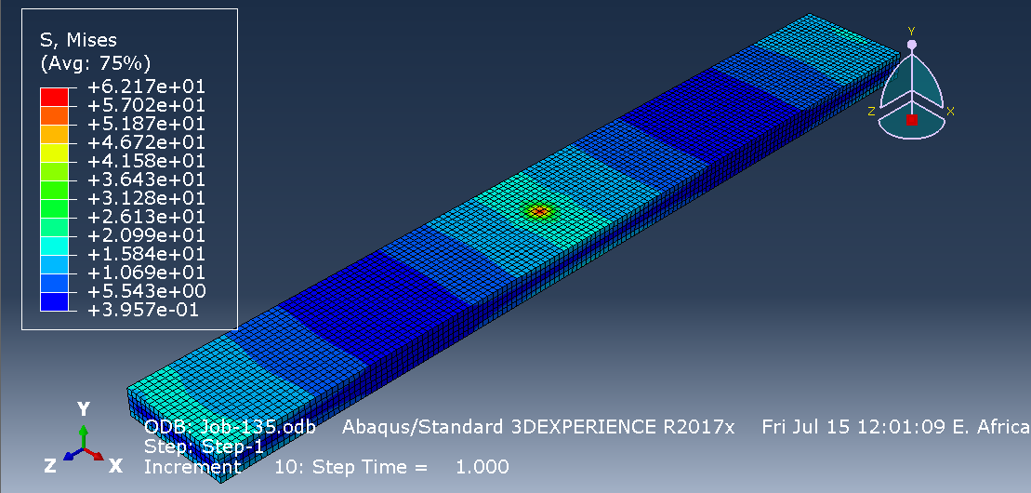
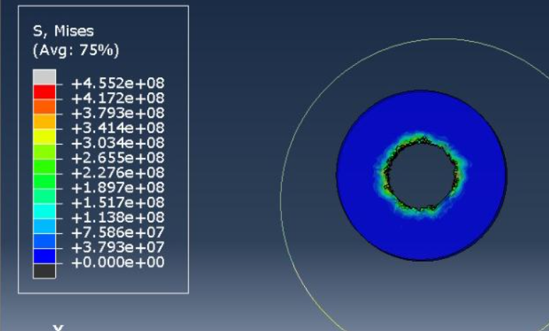
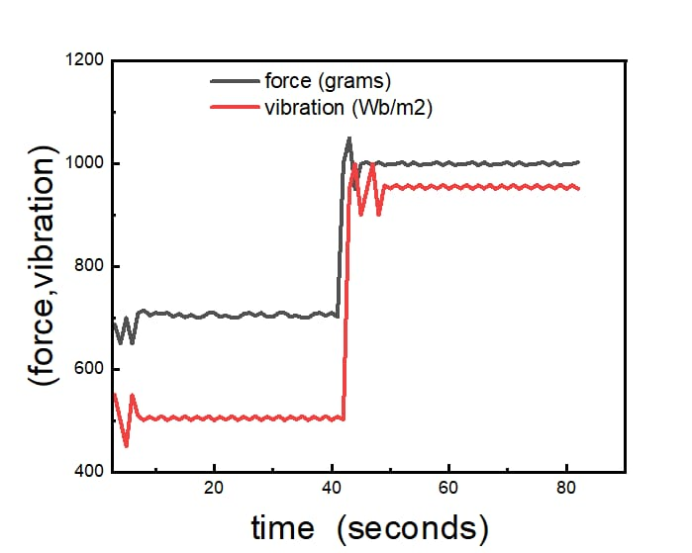
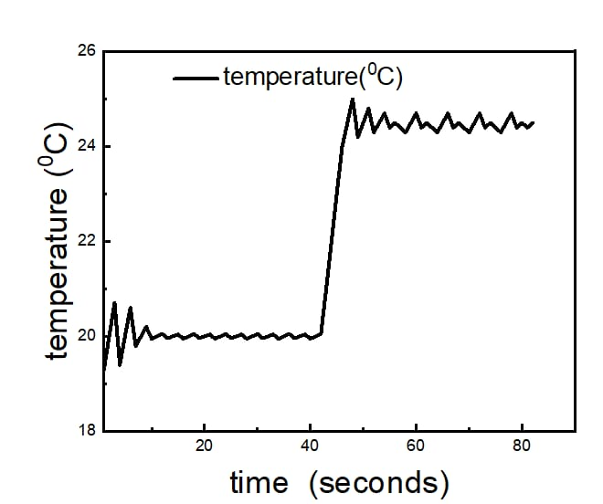
STUDY AND DEVELOPMENT OF
AN AUTOMATED
1-AXIS DRILL
Group members
Calvin Shibiriti.
Silvester Momanyi.
Allan Waithira.
Brilliant Chepkirui.
Joseph Kiarie.
September 2022
Supervisor: Dr. Titus Mulembo
OVERVIEW
PROBLEM STATEMENT
Common problems in drilling include chatter vibrations, drill bit breakage, and work piece damage. This study seeks to use data from force, vibration, and temperature sensors to minimize chatter, and obtain quality cuts without increasing throughput time. Perspex was chosen for study since it resembles the human bone in properties.
INTRODUCTION
Today’s market has simple drilling machines and often, human operator is required to drill the hole. Accuracy cannot be attained properly due to high temperatures which may spoil the job due to human errors. To overcome all these problems, this automated drilling machine is designed which is aimed to drill the holes automatically over a job according to the drilling depth data programmed through a key board.
JUSTIFICATION
There has been an increasing demand for acrylic materials such as PMMA, owing to their mechanical and thermal properties. In the medical industry, the drilling of bone is a common procedure in orthopaedic surgery to produce holes for screw insertion to fixate the fracture devices and implants. PMMA is compatible with the human bone which has promoted its use in orthopedic research.
OBJECTIVES
Condition monitoring when drilling.
Control the operation using STM32 Blue Pill.
Conduct and validate Finite Element Analysis on Abaqus.
EXPERIMENTAL WORK
Sample Sensor Data
Determination of drilling control parameters
Upload the program to the microcontroller
Run the experiment
Results and Data Collection
Evaluation and analysis
Fabricated Drill Set Up
VARIABLES
Feed rate
Spindle speed
Drill bit diameter
Hole Depth
RESULTS
Analysis of PMMA when subjected to a load
Temperature evolution upon drilling
Graph of vibration (Wb/m²) against time (seconds)
Graph of Temperature (Degrees Celsius) against Time (seconds)
CONCLUSION
The condition of the drilling action was monitored using the three sensors; temperature, force, and vibration sensors.
Data was collected and transmitted to an external computer module via Bluetooth.
The data was simulated and analyzed using Matlab.

